Slide 1
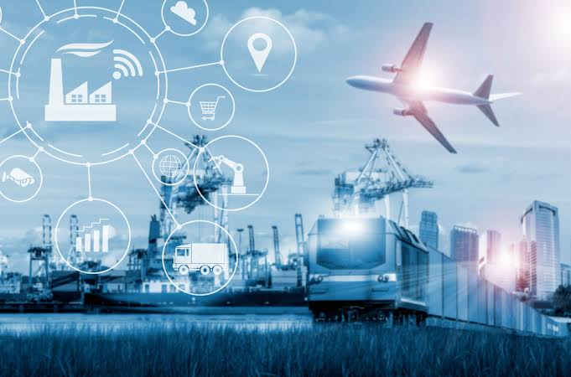
Public transportation optimization
How can IoT improve transportation?
IoT in transportation can also be used to design steering wheel control systems. Information on speed or kilometers traveled alerts driving times and rest breaks. It can also warn drivers or their managers if kilometer-per-hour limits are exceeded.

Slide 2
What is the future of IoT in transportation?
It is also expected that around 88% of the new vehicles will involve IoT telematics by 2025. It ensures business benefits like increased driver safety, better environmental conditions, real-time monitoring of the vehicles, and improved traveling experience.

Slide 3
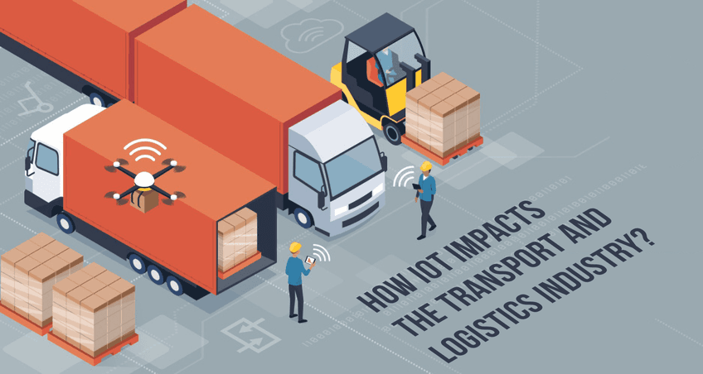
How does IoT affect the transportation industry?
IoT has transformed the industry, making things more efficient, saving money, and making customers happier. Using IoT means better tracking, managing fleets well, being safer, and protecting the environment. As the industry keeps changing, IoT's potential remains strong.

Slide 4
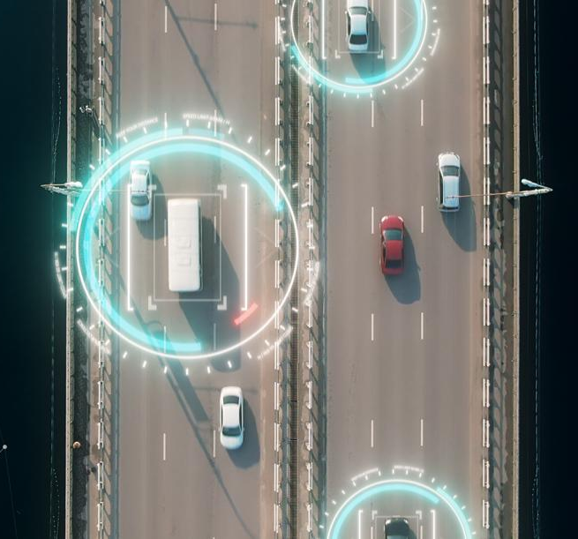
What is connected roadways in IoT?
Smart roads use Internet of Things (IoT) devices to make driving safer, more efficient, and in line with government objectives, greener. Smart roads combine physical infrastructures such as sensors and solar panels with software infrastructure like AI and big data.

Slide 5
How is information technology used in transportation?
Full automation, partial automation, robotics, and AI-enhanced tools that optimize routing can speed up transportation and improve service levels between segments. Sensors, tracking tools, and related logistics technology services monitor vehicles and traffic to provide faster routing options.

